Slide 1
Microsoft® Office
Word 2007 Training
Edit text and revise your documents
Notes:
Before you begin:
Students taking this course should be familiar with how to create and save Word documents, or take the training presentation titled, “Create your first document.”
[Note to trainer: For detailed help in customizing this template, see the very last slide. Also, look for additional lesson text in the notes pane of some slides.]

Slide 2
Course contents
Overview: Moving, selecting, and getting around
Lesson: Make changes to your document
The lesson concludes with a practice session and a short set of questions to test your understanding of the material.
Edit text and revise your documents

Slide 3

Overview: Moving, selecting, and getting around
Have you created a Word document and then wondered how to make changes to it?
In this course, you’ll learn how to get from one place to another in a document so that you can make changes anywhere on the page.
Then you’ll learn how to add and delete text and move it around.
Edit text and revise your documents

Slide 4
Course goals
Move the cursor around a document, using either the mouse or the keyboard, so that you can get to where you need to in order to make changes.
Select text to make revisions.
Move text by cutting and pasting.
Edit text and revise your documents

Slide 5
Lesson
Make changes to your document

Slide 6
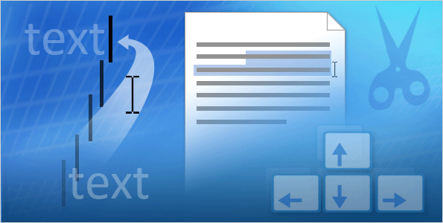
Make changes to your document
Documents get changed.
You may make changes as you type, or after you finish the document.
To work quickly and efficiently in the document, you need to know how to move around.
Once you get to the part of the document you want to edit, you’ll need to type the new text you want to add, or select the existing text so that you can change or delete it.
Edit text and revise your documents
Notes:
The cursor shows you where the text you type will be inserted. You can use either the mouse or the keyboard to get to where you want to make a change.
You can select a word, a sentence, a paragraph, or the entire document. You can also move text to a different location.

Slide 7
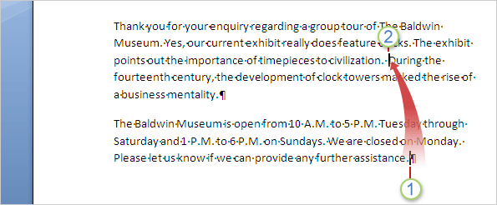


Move around the document
Imagine that you want to type a new sentence between “civilization” and “During”: “Symphonies and constellations have been named for clocks.”
To type where you want, first move the cursor:
The cursor is the vertical line at the end of the second paragraph, in front of the paragraph mark.
You can move the cursor to the first paragraph by moving the pointer and then clicking, or by using the keyboard.
Edit text and revise your documents
Notes:
Here are more details about how to move the cursor:
With your mouse, move the pointer just to the left of “During,” and then click to insert the cursor. Once you start typing, the existing text moves to the right as you enter the new sentence.
Or press the UP ARROW key on your keyboard to move the cursor up one line at a time. Then press the LEFT ARROW key to move the cursor left one character at a time. You can also press CTRL+LEFT ARROW to move left one word at a time.
To get a list of the keys you can use to move around the page, see the Quick Reference Card that’s linked to at the end of the course.

Slide 8
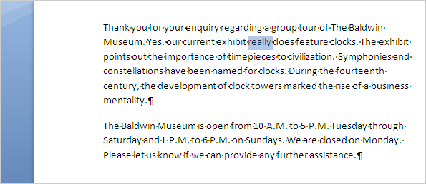
Select and delete text
After adding the sentence to the first paragraph, you read the paragraph.
You think the second sentence will read better if you delete the word “really.”
To delete text, first select what you want to delete. You can do this by using the mouse or the keyboard.
Once “really” is selected, delete the word by pressing DELETE on your keyboard.
Edit text and revise your documents
Notes:
Here are details about the mouse and keyboard methods for selecting text:
Place your pointer over the word “really” and then double-click the word. Or click in front of “really,” hold down the left mouse button, and then drag the pointer over the word.
Or, with the arrow keys on your keyboard, move the cursor next to the text. Then hold down the SHIFT key and press the arrow key that moves the cursor in the correct direction until all the text is selected.

Slide 9
Select and delete text
In the picture, you can see formatting marks: a dot between each word and sentence, and a paragraph mark at the end of each paragraph.
These marks help you when you revise text.
For example, you don’t want to delete the space between words or sentences. One dot between each word or sentence lets you know that the spacing is okay.
Edit text and revise your documents
Notes:
You’ll see how to show and hide formatting marks in the Quick Reference Card that’s linked to at the end of the course.

Slide 10
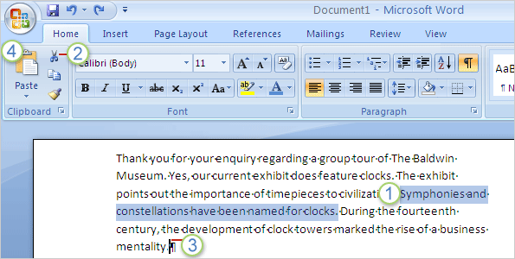
Move text
Still looking at the first paragraph, you decide that the sentence you added should be the last sentence in the paragraph.
You don’t have to delete the sentence and then type it again.
Instead, you can move the sentence by performing a cut-and-paste operation: Cut the sentence to delete it from its current location, and then paste it into the new location.
Edit text and revise your documents

Slide 11
Move text
The picture illustrates what to do.
First select the entire sentence.
Then, on the Ribbon at the top of the window, on the Home tab, in the Clipboard group, click Cut .
Edit text and revise your documents
Notes:
Or use a keyboard shortcut to do the same thing, by pressing CTRL+X (think of the X as scissors). Once you start editing documents, you’ll see how fast and convenient this keyboard shortcut is.

Slide 12


Move text
The picture illustrates what to do.
Move the pointer to the end of the paragraph, where you want the sentence to appear (after the dot formatting mark).
On the Home tab, in the Clipboard group, click Paste . The sentence is pasted in place.
Edit text and revise your documents
Notes:
You can also press the keyboard shortcut CTRL+V to paste.

Slide 13
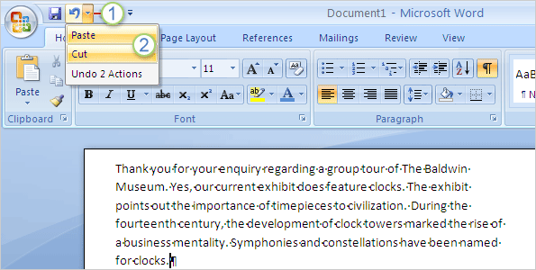
Undo changes
You’ve moved the sentence, but now you’re not happy with the change.
Fortunately, you don’t have to go through the cut-and-paste process again to move the sentence back.
Instead, use Undo:
On the Quick Access Toolbar at the very top of the window, click the arrow on the Undo button .
Edit text and revise your documents

Slide 14
Undo changes
You’ve moved the sentence, but now you’re not happy with the change.
Fortunately, you don’t have to go through the cut-and-paste process again to move the sentence back.
Instead, use Undo:
Move the cursor over the last two actions, Paste and Cut, and then click. This will undo the last two actions you took and place the sentence back in its original location.
Edit text and revise your documents
Notes:
You can also use another handy keyboard shortcut to do the same thing: press CTRL+Z twice.

Slide 15
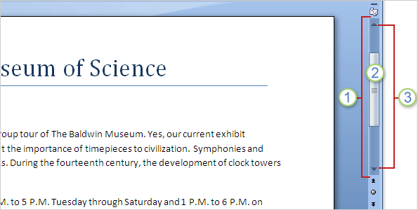
Use the scroll bar to review a document
Perhaps you have a long document that you’d like to read all the way through without having to continuously press the arrow keys to move the cursor.
You can do that by scrolling, using the scroll bar.
The scroll bar is on the right side of the window,
To use it, click the scroll box, and then drag it up or down to move through a document without moving the cursor.
Edit text and revise your documents

Slide 16
Use the scroll bar to review a document
Perhaps you have a long document that you’d like to read all the way through without having to continuously press the arrow keys to move the cursor.
You can do that by scrolling, using the scroll bar.
Or click the single scroll arrows at either end of the scroll bar to move up or down.
Edit text and revise your documents

Slide 17


Use the scroll bar to review a document
Perhaps you have a long document that you’d like to read all the way through without having to continuously press the arrow keys to move the cursor.
To quickly scroll by using your keyboard, press PAGE UP to go up one screen or PAGE DOWN to go down one screen.
Edit text and revise your documents

Slide 18
Suggestions for practice
Show formatting marks.
Move around in the document.
Select text.
Move text.
Online practice (requires Word 2007)
Edit text and revise your documents
Notes:
[Note to trainer: With Word 2007 installed on your computer, you can click the link in the slide to go to an online practice. In the practice, you can work through each of these tasks in Word, with instructions to guide you. Important: If you don’t have Word 2007, you won’t be able to access the practice instructions.]

Slide 19
Test question 1
After you’ve deleted text, you can still get it back. (Pick one answer.)
True.
False.
Edit text and revise your documents

Slide 20
Test question 1: Answer
True.
You can get it back by clicking Undo on the Quick Access Toolbar or by pressing CTRL+Z, as long as you have not yet closed the document or performed any other action that you want to keep.
Edit text and revise your documents

Slide 21
Test question 2
What’s the first thing you do to delete text? (Pick one answer.)
Press DELETE.
Press BACKSPACE.
Select the text you want to delete.
Edit text and revise your documents

Slide 22
Test question 2: Answer
Select the text you want to delete.
Select text by using the mouse pointer or the keyboard, and then press DELETE or BACKSPACE.
Edit text and revise your documents

Slide 23
Test question 3
To move text from one location to another, copy the text. (Pick one answer.)
True.
False.
Edit text and revise your documents

Slide 24
Test question 3: Answer
False.
To move the text from one place, select and then cut the text. Paste it in the new location.
Edit text and revise your documents

